Slide 1

E-COMMERCE SALES DASHBOARD

Slide 2

OBJECTIVE
The Analytics team of an Online E-Commerce Company wants to design a Sales dashboard to analyze the sales based on various product categories. The company wants to add user control for product category, so users can select a category and can see the trend month-wise and product-wise accordingly.
The Analytics team also wants to create a histogram to analyze number of shipping days.

Slide 3

Table of Contents
Understanding Dashboard
Loading Raw Data Into Excel
Creating a Table with Raw Data
Preparing a table of Sales and Profit month-wise in working sheet
Preparing the sales table region-wise in the working sheet
Creating Histogram for Shipping Days(Aging)
Preparing Overall Sales and Profit Table
Creating User Control Combo box for Product Category
Link the tables with combo box
Conclusion
Creating Column Chart of month-wise table, overall sales $ profit table and region-wise table
Category-wise Total Sales, Quantity and Profit
Dashboard

Slide 4

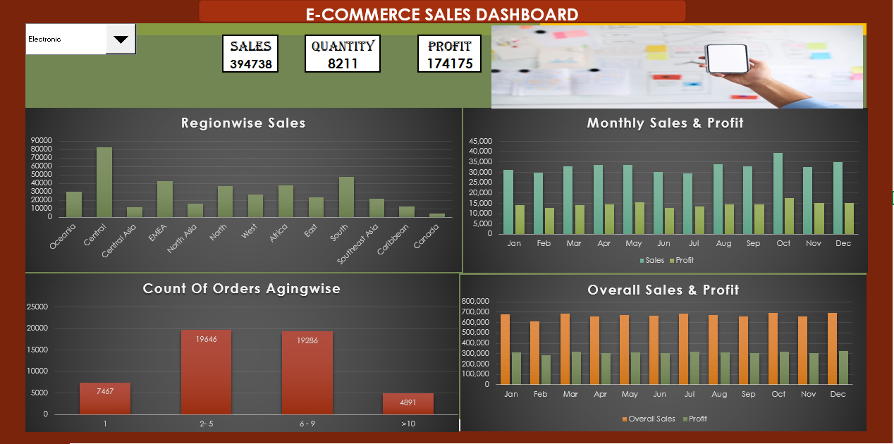
Understanding Dashboard
A Dashboard is a very useful tool that brings together all the data in the form of charts, graphs, histograms, statistics, and many more visualizations which lead to data-driven decision-making. Dashboards contain actionable data. By looking at this data an organization can make key business decisions on the go.

Slide 5
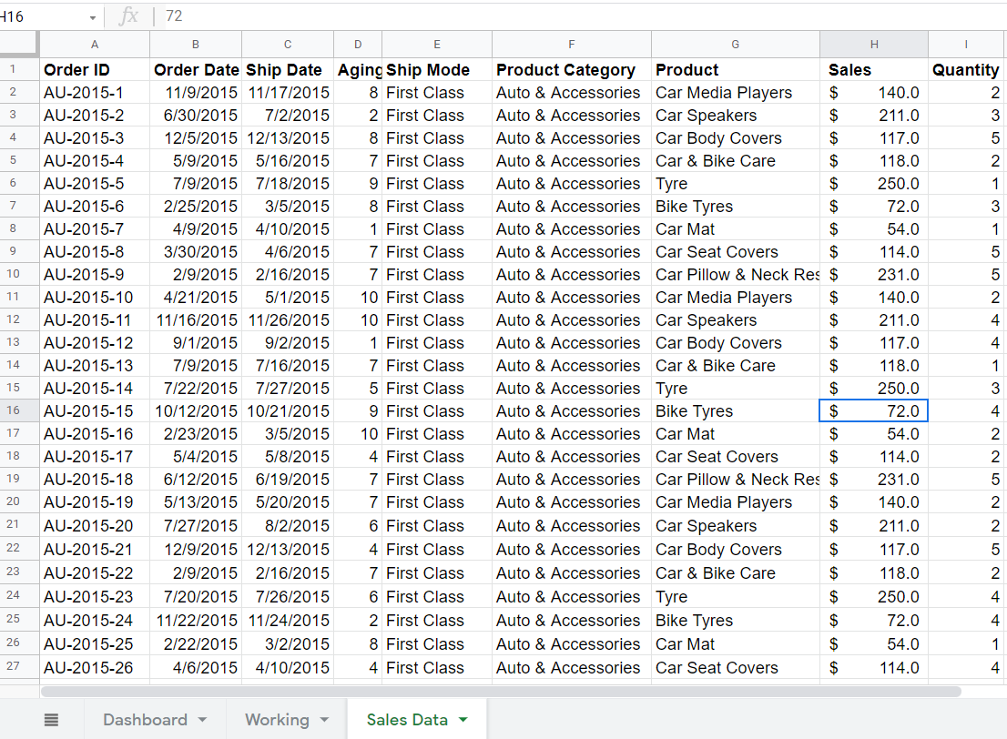
Loading Data
Since the Data is already provided by the in the project description, we just need to open a new Excel Workbook & create 3 tabs/ sheets. One is Sales Dashboard, Working (where we can perform all the needed calculation and table creations ) and Raw Data (here you can hide your raw data).

Slide 6
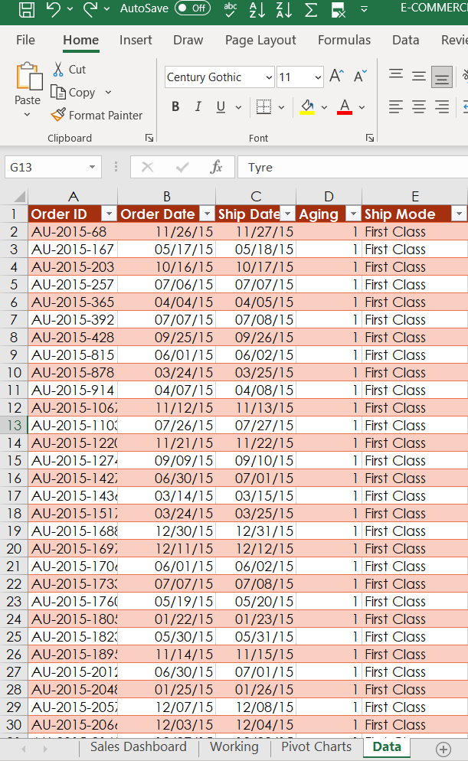
Creating Table With Raw Data
Select the whole data (it can be done by clicking on any of the cell that contains data and then pressing Ctrl+A or it can also be done manually). Then press Ctrl+T or go to the insert tab and select table, this will add a table to our raw data. Then we can do several formattings like adding filters, removing blank spaces if any, adding colors to the table, adding borders around the table etc. to make the table look more presentable in order to easily extract more information from it.

Slide 7
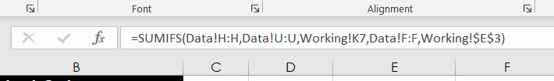
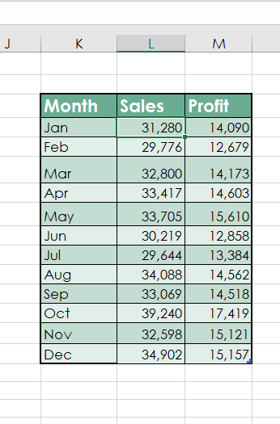

Preparing Table of Sales and Profit Month-wise in Working Sheet
Sales calculation
Using the SUMIFS formula for both sales and profit column we can find out month-wise profit and sales for a particular product category that we choose from the combo box. Then format this data into a table as we did previously.
Profit calculation

Slide 8
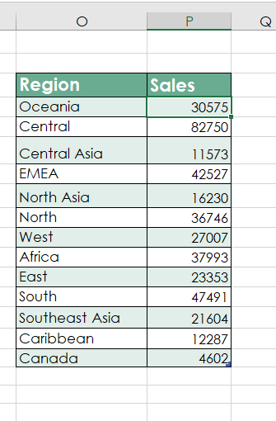
Preparing the sales table region-wise in the working sheet
Region-wise Sales Calculation
Using the SUMIFS formulae we can find out the region-wise sales for a particular product that we have chosen from the combo box.
Use SUMIFS and put conditions in it for product category and region.

Slide 9
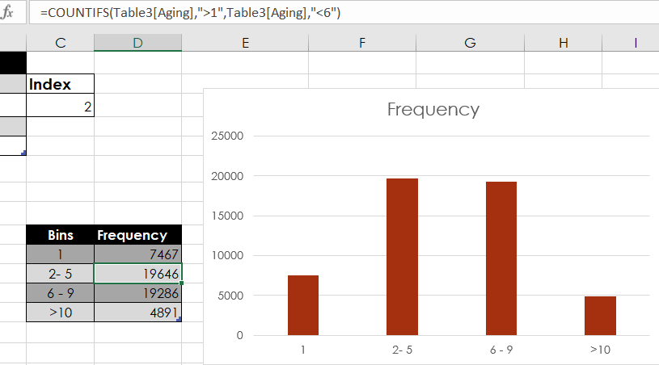
Creating Histogram for Shipping Days(Aging)
Calculation for Creating Frequency Bin Table
To create histogram, click the Data Tab, Under Analysis Group (Right Corner), Click Data Analysis.
Now, select Histogram and click ok. A histogram dialog box will appear.
Make the required adjustments in the dialog box and then click OK.
Frequency table

Slide 10

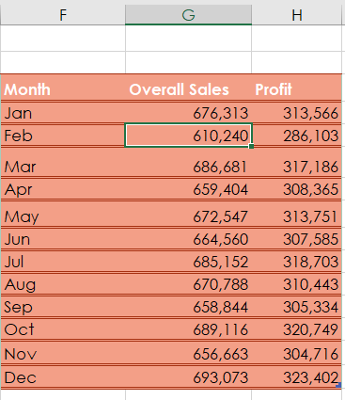

Preparing Overall Sales and Profit Table
Overall profit calculation
To find the overall sales and profit for a particular product use the SUMIFS formulae
Enter and equals to sign then write the function name (i.e., SUMIFS) and select the sum range, then criteria range1 and lastly the criteria.
Repeat this for both sales and profit column.
Table
Overall sales calculation

Slide 11
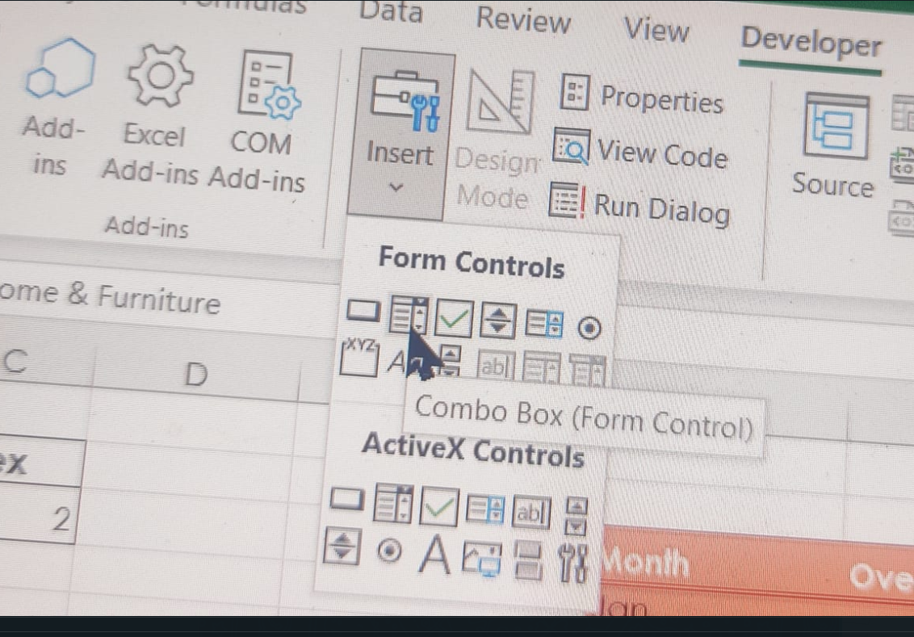
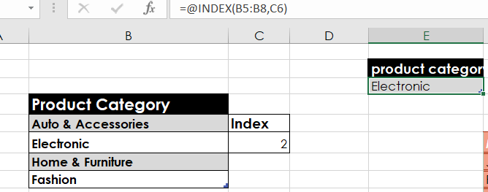
Creating User Control Combo box for Product Category
Inserting combo box
To draw a combo box, click Developer Tab > Under Controls Panel > Click Combo box and draw the combo box.
Pass the Input Range and Cell for the Combo box.
Right-click the country list Combo box > Click Format Control > Under Format Control Panel, Pass Input Range and Cell Link from the working sheet.
Creating link between combo box and product category

Slide 12
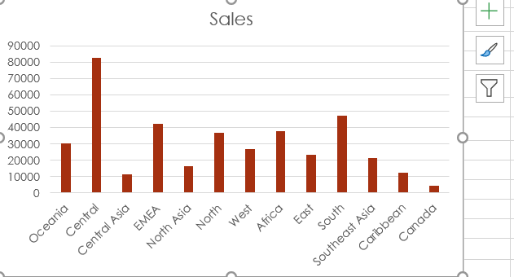
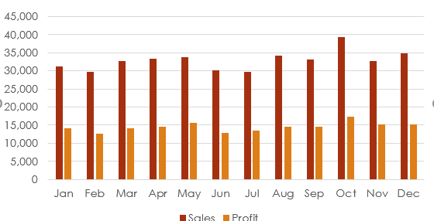
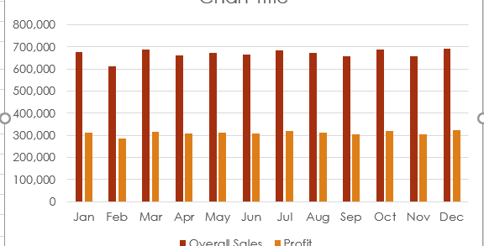
Creating Column Chart of month-wise table, overall sales $ profit table and region-wise table
To create the column chart for both region-wise and month-wise table, select the table that contains the data for which we want to create the column chart
Click insert tab > under Charts Panel > Insert column chart.
Cut and Paste the chart in the Dashboard Sheet.
Perform the same steps for other tables to create chart.

Slide 13




Category-wise Total Sales, Quantity and Profit
Category-wise
Total profit calculation
Use SUMIFS formula to calculate total Sales, Quantity, and Profit in the Dashboard sheet.
Enter the equal sign and then enter the function name and open parenthesis.
Pass the first Argument Sum Range.
Now, pass the second argument Product Category column “criteria Range1”
Finally, pass the third argument “criteria1”
Total quantity calculation
Total sales calculation

Slide 14
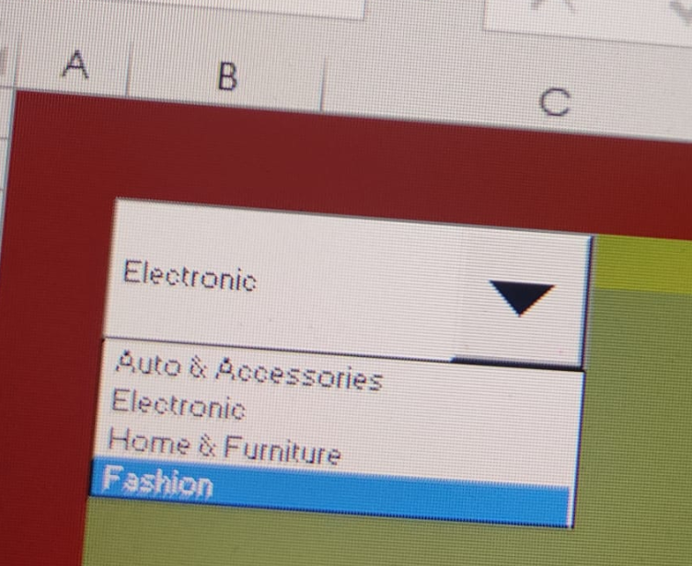
Link the tables with combo box
Link Combo box for product category list in the Dashboard Sheet.
Click Developer Tab > Under Controls Panel > Click Combo box and draw.
Pass the Input Range and Cell for the Combo box.
Right-click the category list Combo box > Click Format Control > Under Format Control Panel, Pass Input Range and Cell Link from the working sheet
User control combo box

Slide 16

Conclusion
We learnt to create histograms, column charts
Organize raw data into a table
Explored various formatting options
Learnt how to create a combo box and to link it to the data.

